Slide 1
DSP PROJECT
AUDIO SIGNAL DENOISING USING DIFFERENT METHODS
Veronika Y Pakpahan
2005953

Slide 2
Introduction
Background :
In processing digital signal, removing noise is an important first step to do. There are few algorithms that can be applied to denoise the data signal. It is important to know the most effective way to denoise the audio signal.
Goal :
To denoise the signal using several methods and compare the result and finding the most effective way.

Slide 3
METHODS
There are 3 methods that have been applied to denoise the audio signal :
Fast Fourier Transform and Lowpass Filter (in .m4a and .wav types of file)
Filter Design Method using design filter extension MATLAB
Wavelets Decomposition Method

Slide 4
1. Fast Fourier Transform & Lowpass Filter
A. USING .M4A TYPE OF AUDIO FILE
Reading Audio1.m4a Audio file
Transform the time domain signal into Frequency Domain using Fast Fourier Transform (FFT)
Filter the low frequency using Low Pass Frequency Filter Method
Plot the signals and compare the unfiltered and filtered data

Slide 5
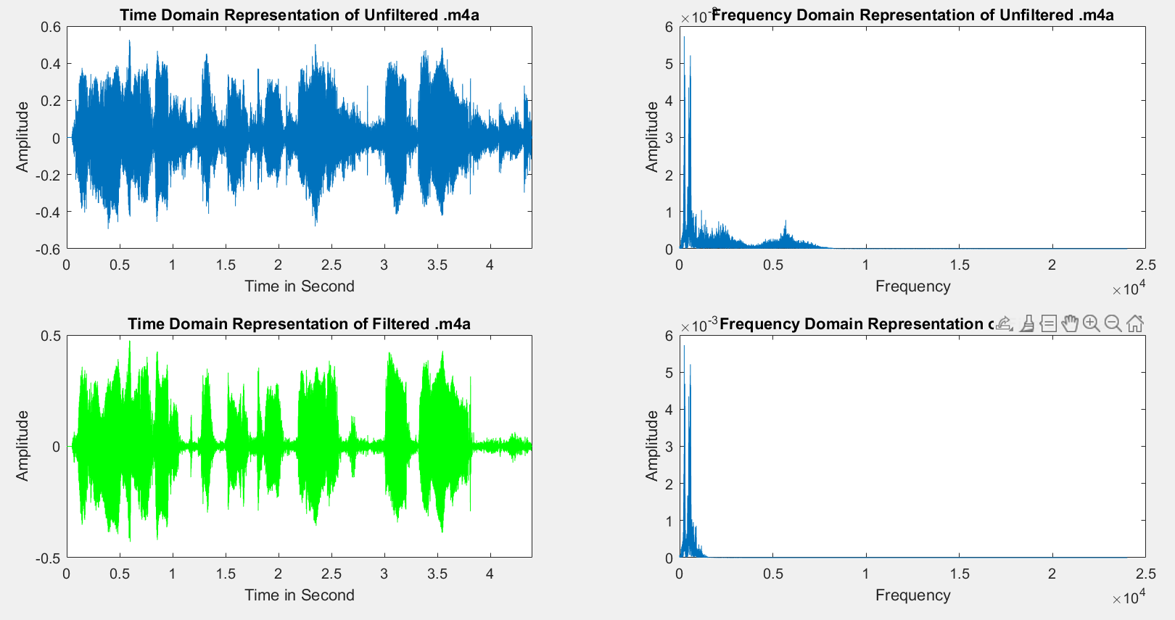
1. Fast Fourier Transform & Lowpass Filter
A. USING .M4A TYPE OF AUDIO FILE

Slide 6

1. Fast Fourier Transform & Lowpass Filter
B. USING WAV TYPE OF FILE

Slide 7
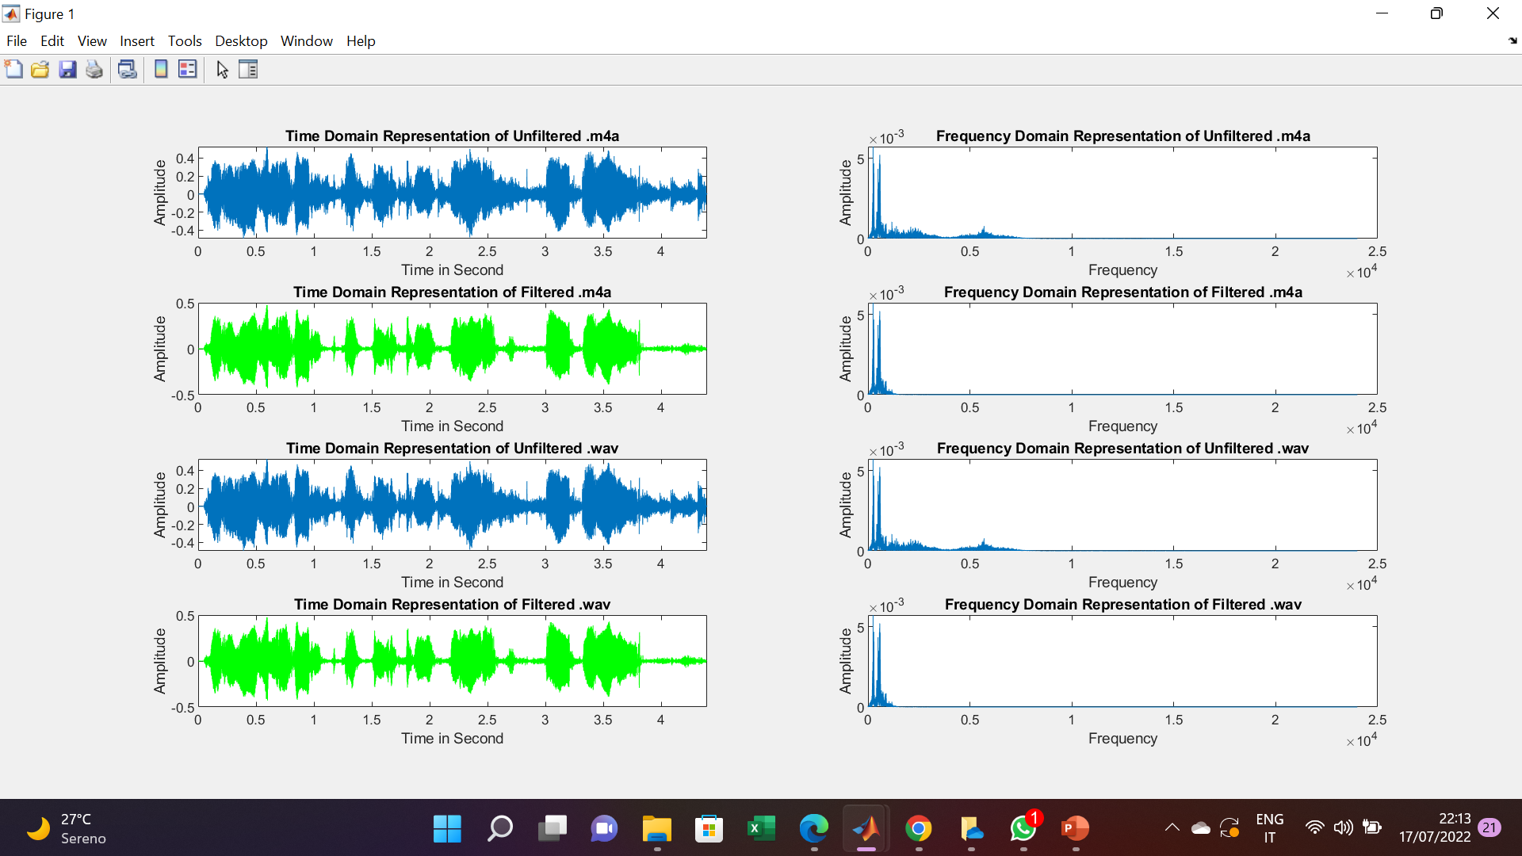
1. Fast Fourier Transform & Lowpass Filter

Slide 8
2. Filter Design Method
Read the Audio1.m4a file with audioread syntax
Build a function ‘LowPass4k’ using Filter Design algorithm MATLAB
I choose 1000 Hz as Cut off frequency
Filter the signal using the function which already built ‘LowPass4k’
Plot original signal and the denoised signal

Slide 9
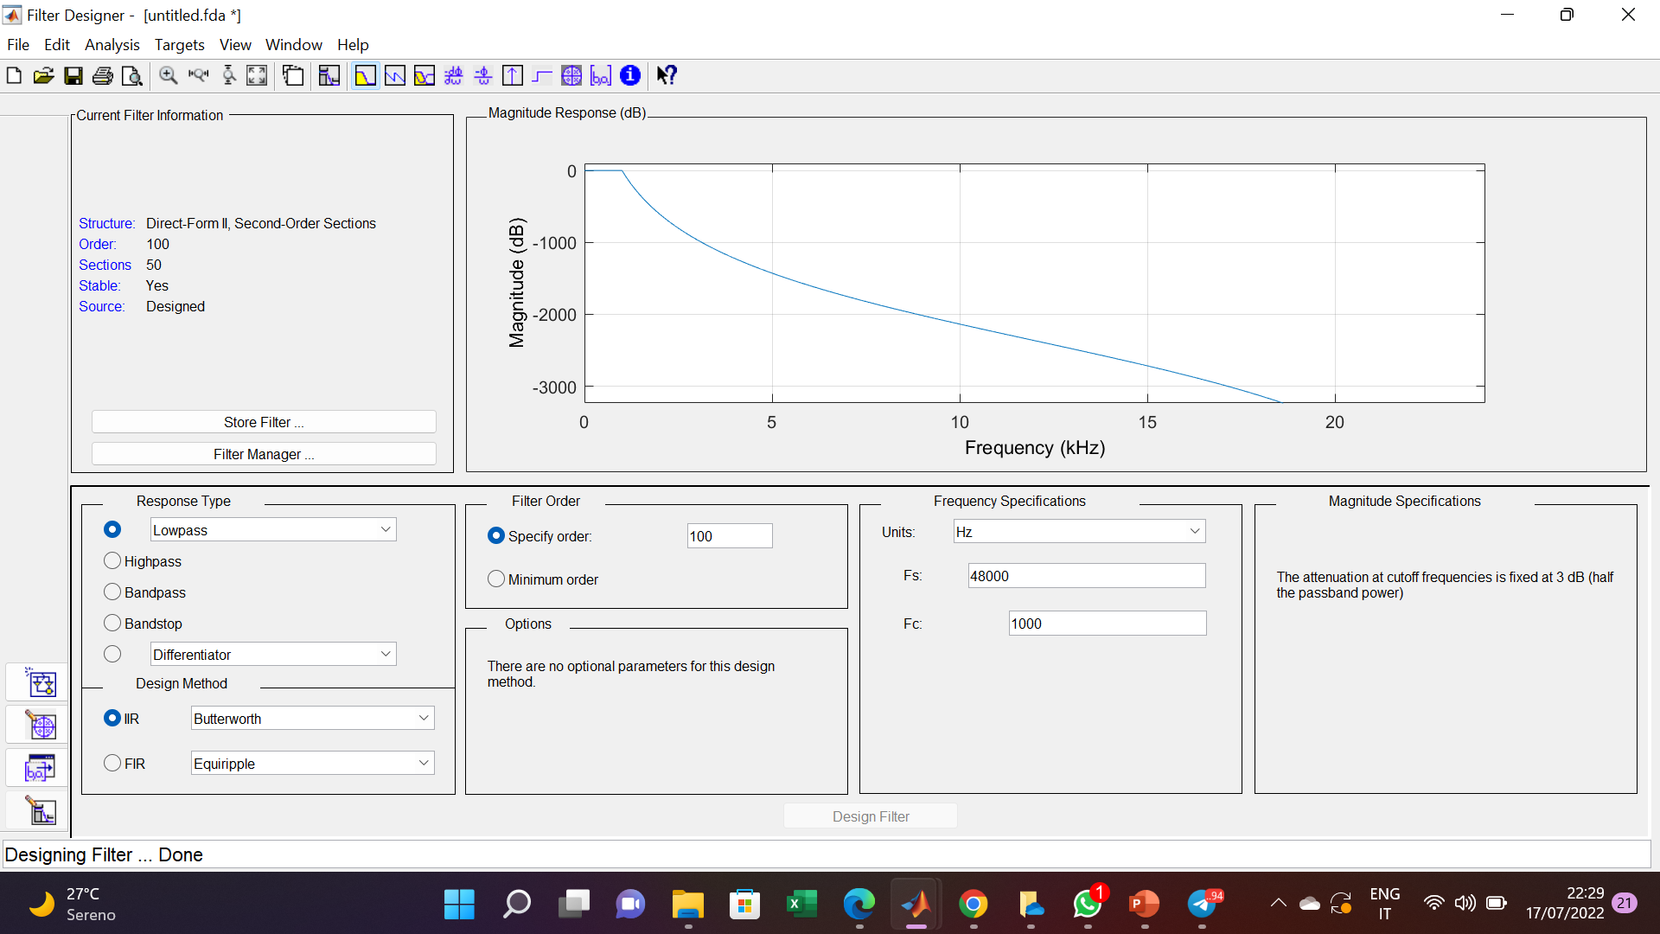
2. Filter Design Method

Slide 10
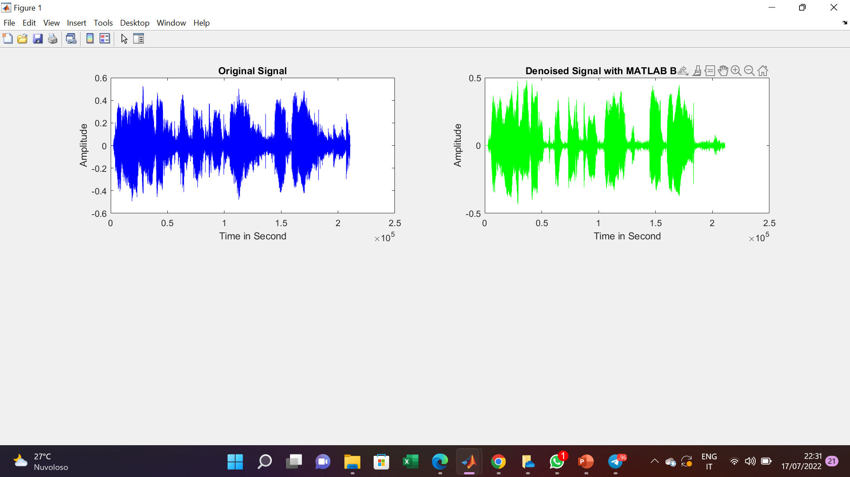
2. Filter Design Method

Slide 11
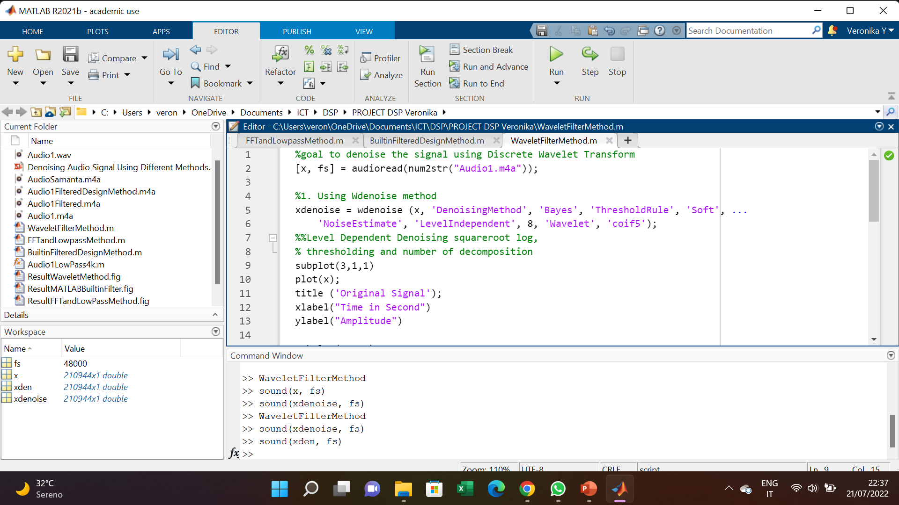
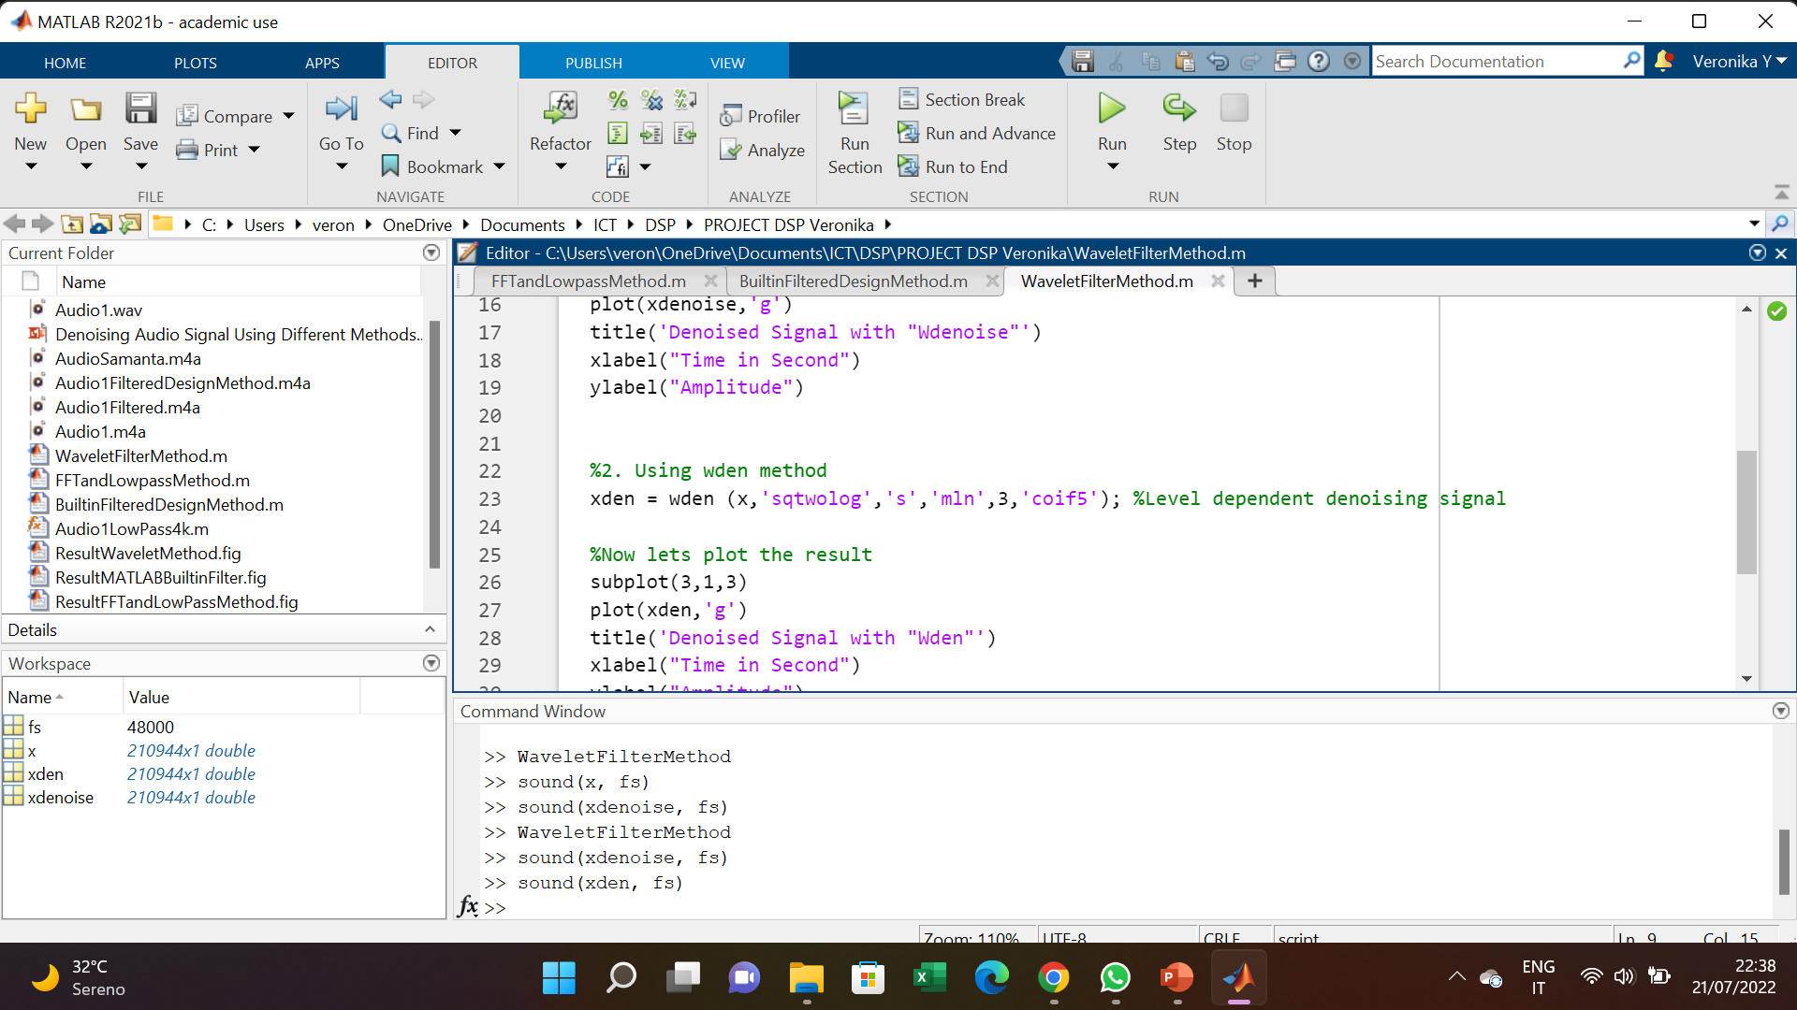
3. Wavelet Decomposition Filter
Read the Audio1.m4a using audio read
Filter using the Wavelet Transform:
Wdenoise
Wden
3. Plot and Compare the result

Slide 12
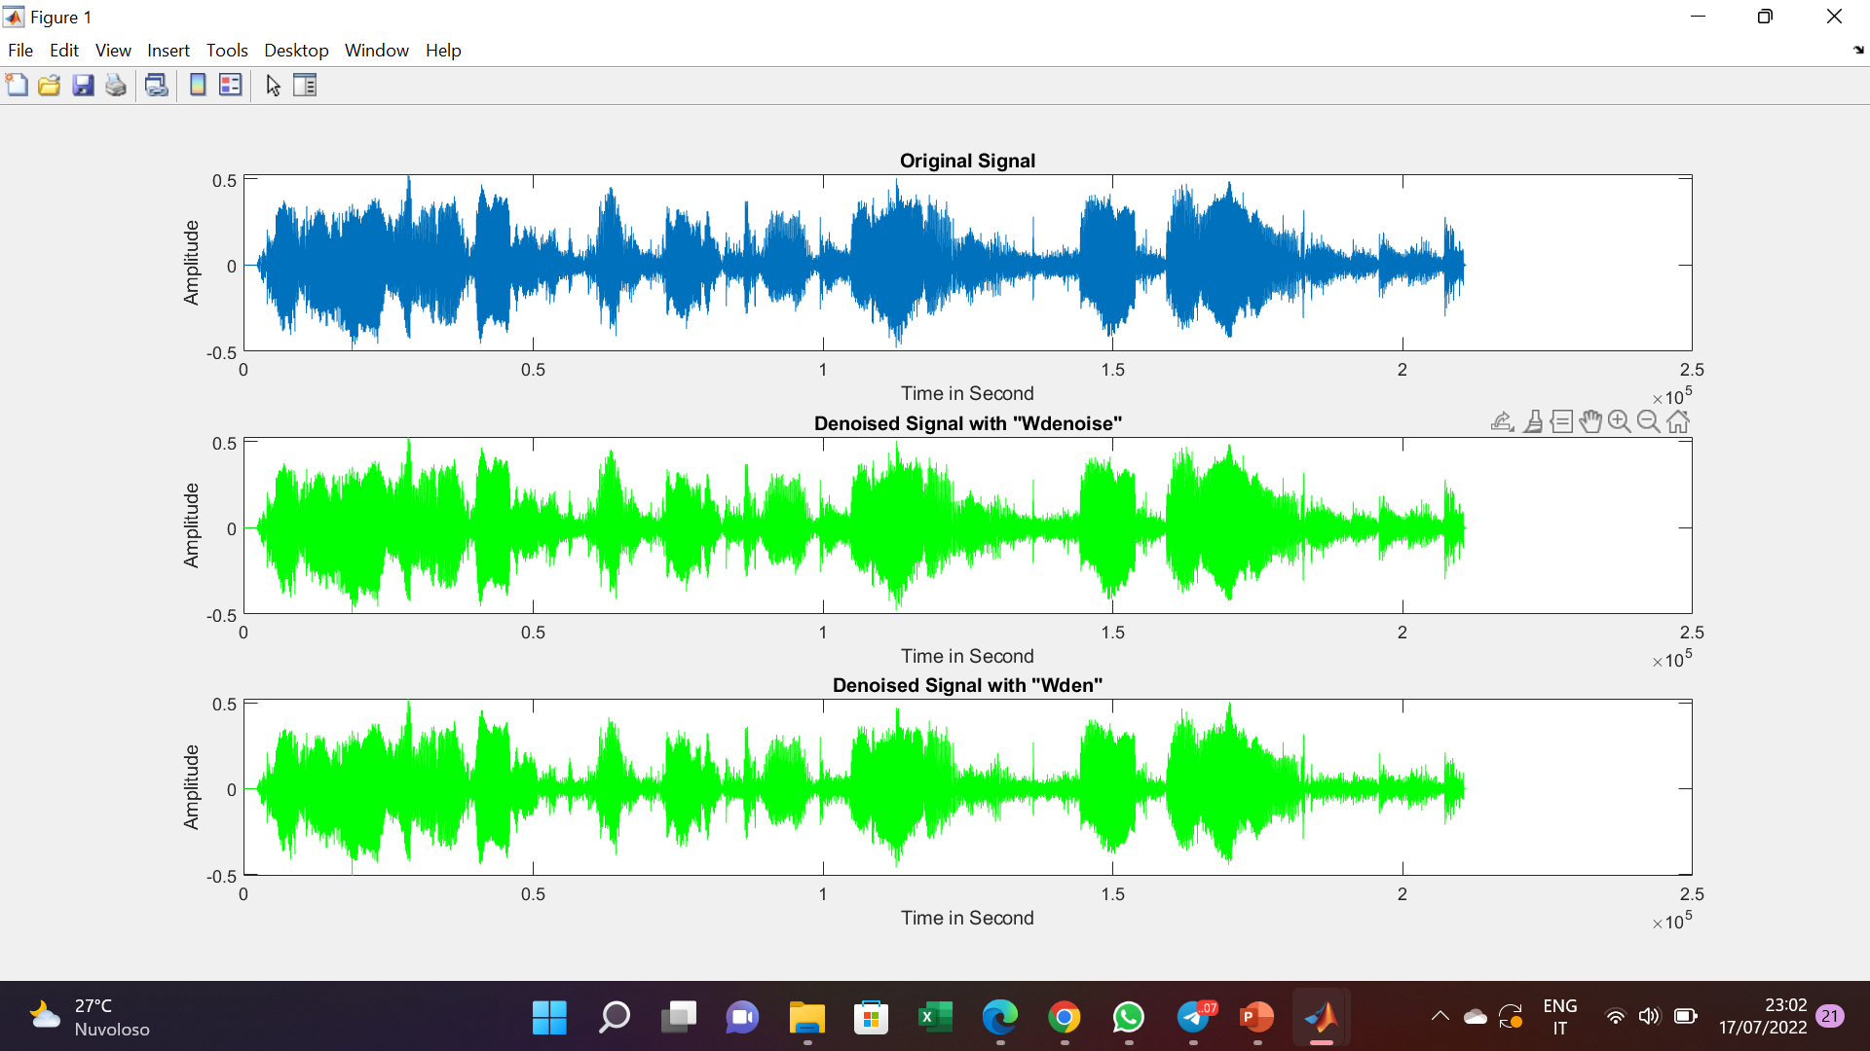
3. Wavelet Decomposition Filter

Slide 13
RESULT & CONCLUSION
FFT and Lowpass filter perform better than other 2 methods
Built in Design also perform well in denoising the signal
Wavelet transform is not a good choice for audio signal denoising

